Slide 1
Dynamic Programming
Steps.
  View the problem solution as the result of a sequence of decisions.
  Obtain a formulation for the problem state.
  Verify that the principle of optimality holds.
  Set up the dynamic programming recurrence equations.
  Solve these equations for the value of the optimal solution.
  Perform a traceback to determine the optimal solution.

Slide 2

Dynamic Programming
When solving the dynamic programming recurrence recursively, be sure to avoid the recomputation of the optimal value for the same problem state.
To minimize run time overheads, and hence to reduce actual run time, dynamic programming recurrences are almost always solved iteratively (no recursion).

Slide 3

0/1 Knapsack Recurrence
If w_{n} <= y, f(n,y) = p_{n}.
If w_{n} > y, f(n,y) = 0.
When i < n
  f(i,y) = f(i+1,y) whenever y < w_{i}.
  f(i,y) = max{f(i+1,y), f(i+1,y-w_{i}) + p_{i}}, y >= w_{i}.
Assume the weights and capacity are integers.
Only f(i,y)s with 1 <= i <= n and 0 <= y <= c are of interest.

Slide 4
Iterative Solution Example
n = 5, c = 8, w = [4,3,5,6,2], p = [9,7,10,9,3]
0
1
2
3
4
5
6
7
8
f[i][y]
5
4
i
3
2
1
y
Notes:
Note: no recomputation recursive version computes f(1,c) and some (maybe even all)
f(i,y), i > 1, 0 <= y <= c. Iterative version computes f(1,c) and all f(i,y), i > 1, 0 <= y <= c.

Slide 5
Compute f[5][*]
n = 5, c = 8, w = [4,3,5,6,2], p = [9,7,10,9,3]
0
1
2
3
4
5
6
7
8
f[i][y]
5
0
0
3
3
3
3
3
3
3
4
i
3
2
1
y

Slide 6
Compute f[4][*]
n = 5, c = 8, w = [4,3,5,6,2], p = [9,8,10,9,3]
0
1
2
3
4
5
6
7
8
f[i][y]
5
0
0
3
3
3
3
3
3
3
4
0
0
3
3
3
3
9
9
12
i
3
2
1
y
f(i,y) = max{f(i+1,y), f(i+1,y-w_{i}) + p_{i}}, y >= w_{i}

Slide 7
Compute f[3][*]
n = 5, c = 8, w = [4,3,5,6,2], p = [9,8,10,9,3]
0
1
2
3
4
5
6
7
8
f[i][y]
5
0
0
3
3
3
3
3
3
3
4
0
0
3
3
3
3
9
9
12
i
3
0
0
3
3
3
10
10
13
13
2
1
y
f(i,y) = max{f(i+1,y), f(i+1,y-w_{i}) + p_{i}}, y >= w_{i}

Slide 8
Compute f[2][*]
n = 5, c = 8, w = [4,3,5,6,2], p = [9,8,10,9,3]
0
1
2
3
4
5
6
7
8
f[i][y]
5
0
0
3
3
3
3
3
3
3
4
0
0
3
3
3
3
9
9
12
i
3
0
0
3
3
3
10
10
13
13
2
0
0
3
8
8
11
11
13
18
1
y
f(i,y) = max{f(i+1,y), f(i+1,y-w_{i}) + p_{i}}, y >= w_{i}

Slide 9
Compute f[1][c]
n = 5, c = 8, w = [4,3,5,6,2], p = [9,8,10,9,3]
0
1
2
3
4
5
6
7
8
f[i][y]
5
0
0
3
3
3
3
3
3
3
4
0
0
3
3
3
3
9
9
12
i
3
0
0
3
3
3
10
10
13
13
2
0
0
3
8
8
11
11
13
18
1
18
y
f(i,y) = max{f(i+1,y), f(i+1,y-w_{i}) + p_{i}}, y >= w_{i}

Slide 10
Iterative Implementation
// initialize f[n][]
int yMax = Math.min(w[n] - 1, c);
for (int y = 0; y <= yMax; y++)
f[n][y] = 0;
for (int y = w[n]; y <= c; y++)
f[n][y] = p[n];

Slide 11
Iterative Implementation
// compute f[i][y], 1 < i < n
for (int i = n - 1; i > 1; i--)
{
yMax = Math.min(w[i] - 1, c);
for (int y = 0; y <= yMax; y++)
f[i][y] = f[i + 1][y];
for (int y = w[i]; y <= c; y++)
f[i][y] = Math.max(f[i + 1][y],
f[i + 1][y - w[i]] + p[i]);
}

Slide 12
Iterative Implementation
// compute f[1][c]
f[1][c] = f[2][c];
if (c >= w[1])
f[1][c] = Math.max(f[1][c],
f[2][c-w[1]] + p[1]);
}

Slide 13

Time Complexity
O(cn).
Same as for the recursive version with no recomputations.
Iterative version is expected to run faster because of lower overheads.
  No checks to see if f[i][j] already computed (but all f[i][j] are computed).
  Method calls replaced by for loops.

Slide 14
Traceback
n = 5, c = 8, w = [4,3,5,6,2], p = [9,8,10,9,3]
0
1
2
3
4
5
6
7
8
f[i][y]
5
0
0
3
3
3
3
3
3
3
4
0
0
3
3
3
3
9
9
12
i
3
0
0
3
3
3
10
10
13
13
2
0
0
3
8
8
11
11
13
18
1
18
y
f[1][8] = f[2][8] => x₁ = 0

Slide 15
Traceback
n = 5, c = 8, w = [4,3,5,6,2], p = [9,8,10,9,3]
0
1
2
3
4
5
6
7
8
f[i][y]
5
0
0
3
3
3
3
3
3
3
4
0
0
3
3
3
3
9
9
12
i
3
0
0
3
3
3
10
10
10
13
13
2
0
0
3
8
8
11
11
13
18
1
18
y
f[2][8] != f[3][8] => x₂ = 1

Slide 16
Traceback
n = 5, c = 8, w = [4,3,5,6,2], p = [9,8,10,9,3]
0
1
2
3
4
5
6
7
8
f[i][y]
5
0
0
3
3
3
3
3
3
3
4
0
0
0
3
3
3
3
9
9
12
i
3
0
0
3
3
3
10
10
13
13
2
0
0
3
8
8
11
11
13
18
1
18
y
f[3][5] != f[4][5] => x₃ = 1

Slide 17
Traceback
n = 5, c = 8, w = [4,3,5,6,2], p = [9,8,10,9,3]
0
1
2
3
4
5
6
7
8
f[i][y]
5
0
0
3
3
3
3
3
3
3
4
0
0
3
3
3
3
9
9
12
i
3
0
0
3
3
3
10
10
13
13
2
0
0
3
8
8
11
11
13
18
1
18
y
f[4][0] = f[5][0] => x₄ = 0

Slide 18
Traceback
n = 5, c = 8, w = [4,3,5,6,2], p = [9,8,10,9,3]
0
1
2
3
4
5
6
7
8
f[i][y]
5
0
0
3
3
3
3
3
3
3
4
0
0
3
3
3
3
9
9
12
i
3
0
0
3
3
3
10
10
13
13
2
0
0
3
8
8
11
11
13
18
1
18
y
f[5][0] = 0 => x₅ = 0

Slide 19
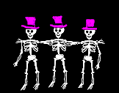
Complexity Of Traceback
O(n)

Slide 20
Matrix Multiplication Chains
Multiply an m x n matrix A and an n x p matrix B to get an m x p matrix C.
n
C(i,j) =
A(i,k) * B(k,j)
k = 1
We shall use the number of multiplications as our complexity measure.
n multiplications are needed to compute one C(i,j).
mnp multiplicatons are needed to compute all mp terms of C.

Slide 21
Matrix Multiplication Chains
Suppose that we are to compute the product X*Y*Z of three matrices X, Y and Z.
The matrix dimensions are:
  X:(100 x 1), Y:(1 x 100), Z:(100 x 1)
Multiply X and Y to get a 100 x 100 matrix T.
  100 * 1 * 100 = 10,000 multiplications.
Multiply T and Z to get the 100 x 1 answer.
  100 * 100 * 1 = 10,000 multiplications.
Total cost is 20,000 multiplications.
10,000 units of space are needed for T.

Slide 22
Matrix Multiplication Chains
The matrix dimensions are:
  X:(100 x 1)
  Y:(1 x 100)
  Z:(100 x 1)
Multiply Y and Z to get a 1 x 1 matrix T.
  1 * 100 * 1 = 100 multiplications.
Multiply X and T to get the 100 x 1 answer.
  100 * 1 * 1 = 100 multiplications.
Total cost is 200 multiplications.
1 unit of space is needed for T.

Slide 23
Product Of 5 Matrices
Some of the ways in which the product of 5 matrices may be computed.
  A*(B*(C*(D*E))) right to left
  (((A*B)*C)*D)*E left to right
  (A*B)*((C*D)*E)
  (A*B)*(C*(D*E))
  (A*(B*C))*(D*E)
  ((A*B)*C)*(D*E)

Slide 24


Find Best Multiplication Order
Number of ways to compute the product of q matrices is O(4^{q}/q^{1.5}).
Evaluating all ways to compute the product takes O(4^{q}/q^{0.5}) time.

Slide 25

An Application
Registration of pre- and post-operative 3D brain MRI images to determine volume of removed tumor.

Slide 26
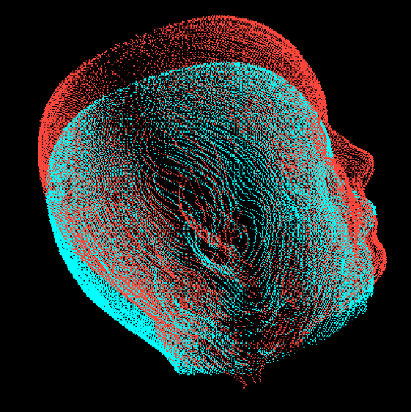
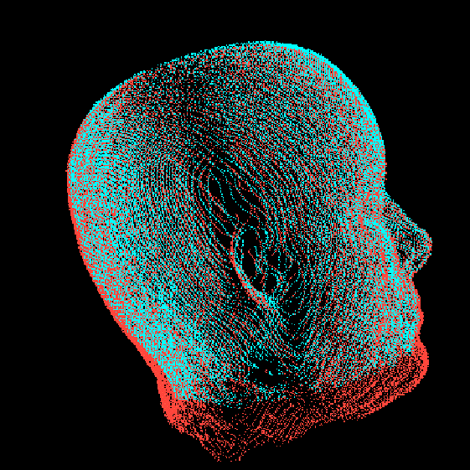
3D Registration

Slide 27
3D Registration
Each image has 256 x 256 x 256 voxels.
In each iteration of the registration algorithm, the product of three matrices is computed at each voxel … (12 x 3) * (3 x 3) * (3 x 1)
Left to right computation => 12 * 3 * 3 + 12 * 3*1 = 144 multiplications per voxel per iteration.
100 iterations to converge.

Slide 28
3D Registration
Total number of multiplications is about 2.4 * 10¹¹.
Right to left computation => 3 * 3*1 + 12 * 3 * 1 = 45 multiplications per voxel per iteration.
Total number of multiplications is about 7.5 * 10¹⁰.
With 10⁸ multiplications per second, time is 40 min vs 12.5 min.

